Slide 1
Population models to prioritize bycatch mitigation options
Selina Heppell
Oregon State University
Department of Fisheries, Wildlife, and Conservation Sciences

Slide 2
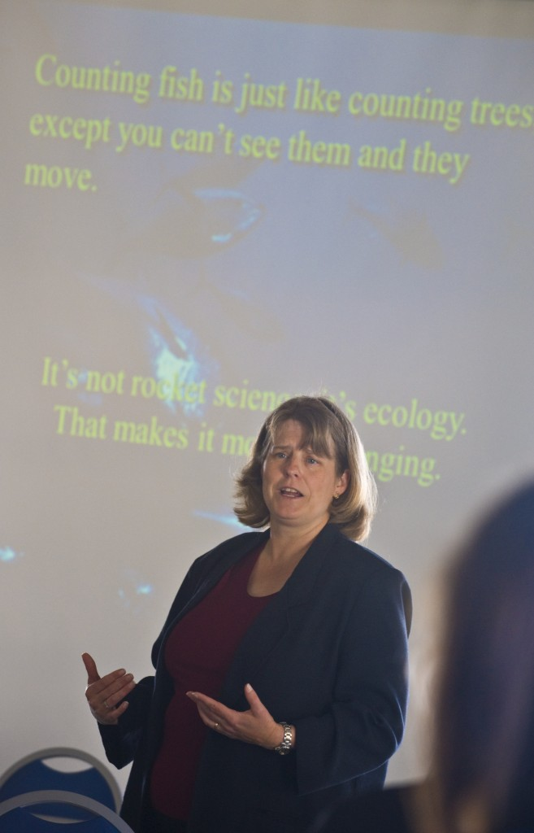
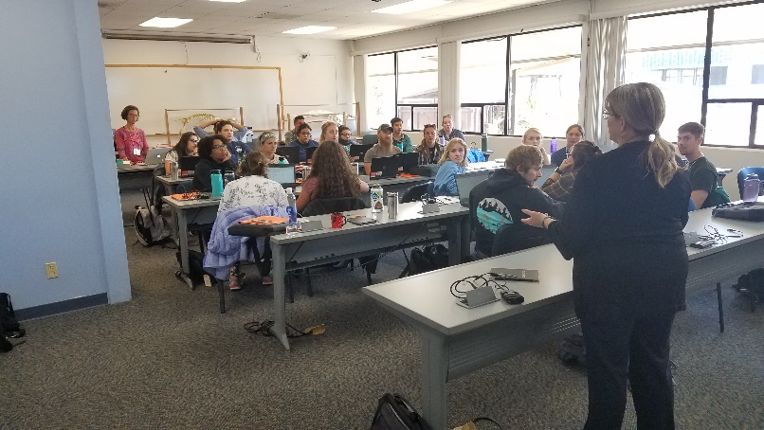
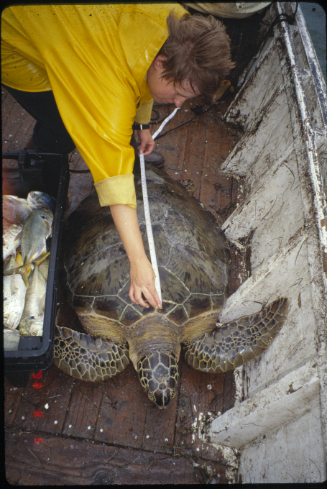
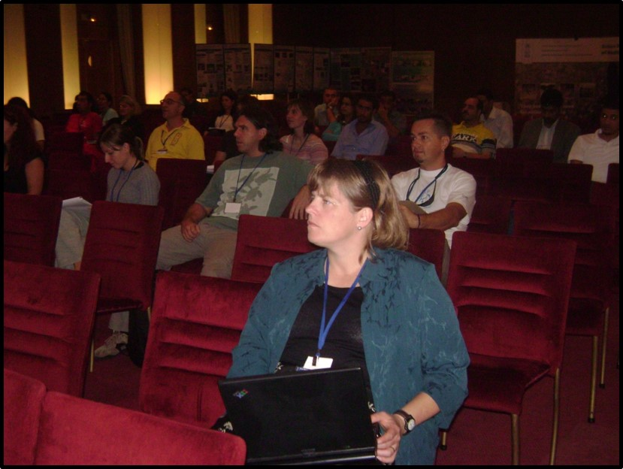
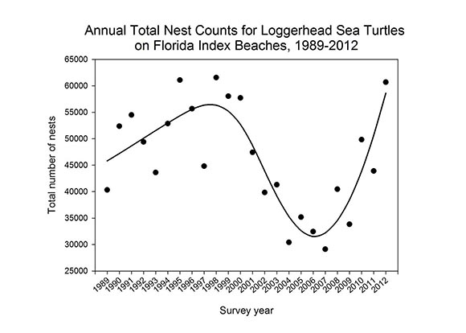

Slide 3
Uncertainty increases with decreasing fishery data
Direct harvest Bycatch Indirect effects
Grouper, tuna red snapper, albatross, sea turtles Food web changes,
climate impacts
Increasing uncertainty of human impact on population dynamics and efficacy of management alternatives

Slide 4
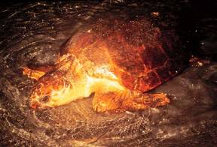
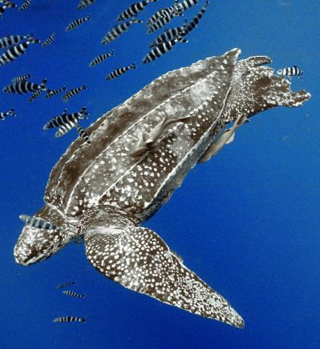
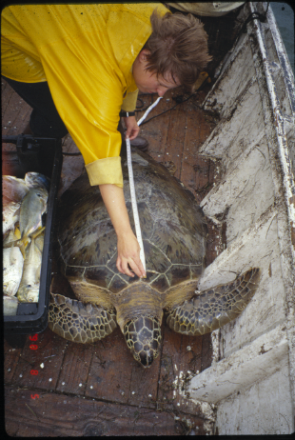
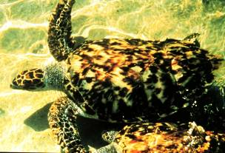
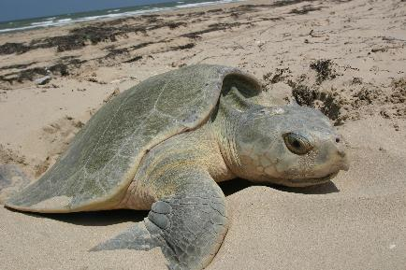
U.S. sea turtle species:
Leatherback
(Dermochelys coriaciea)
Endangered
Loggerhead (Caretta caretta)
Threatened
Green
(Chelonia mydas)
Endangered
Hawksbill (Eretmochelys imbricata)
Endangered
Banco de Imagens Projeto Tamar
Kemp’s ridley
(Lepidochelys kempi)
Endangered
Olive ridley
(Lepidochelys olivacea)
Threatened

Slide 5

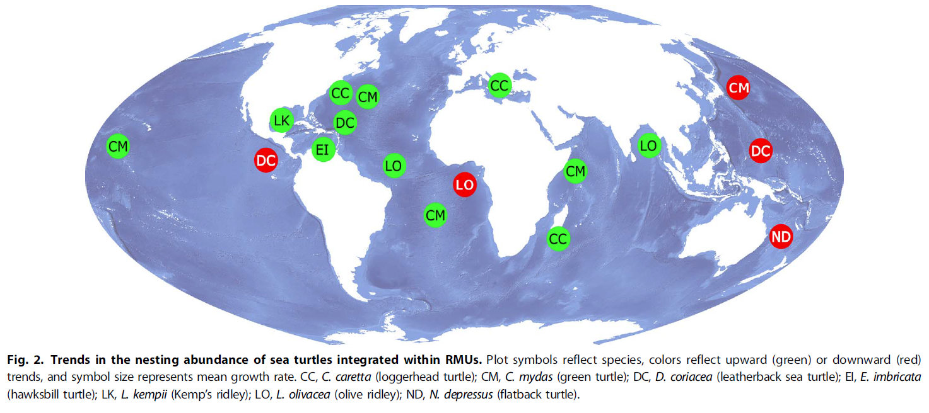

Slide 6
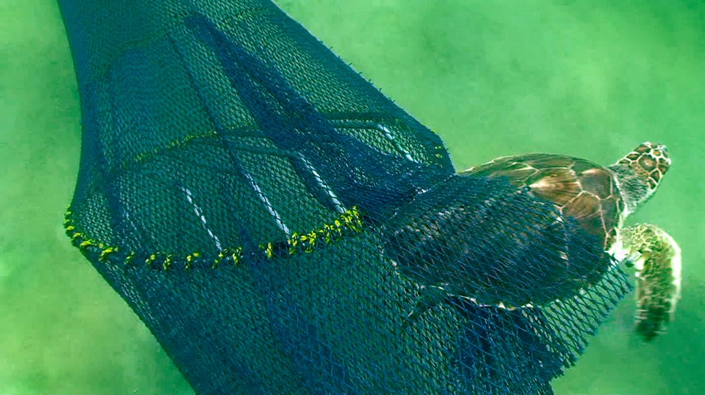
Turtle Excluder Device (TED)

Slide 7
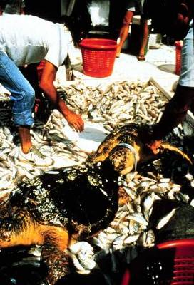
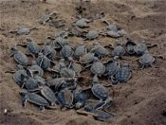
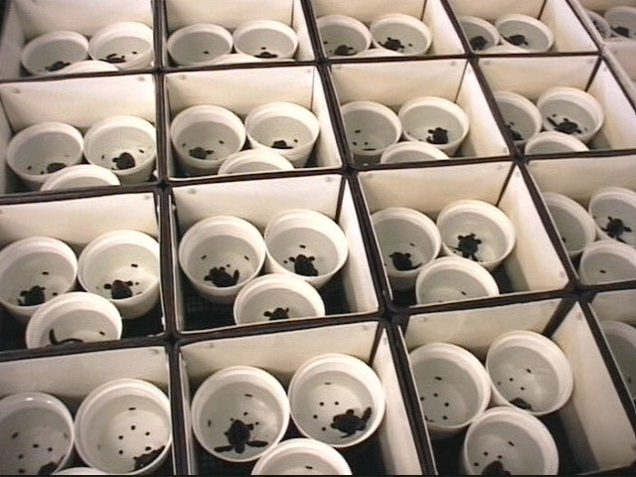
Management options in U.S. in 1980s
Focus on nests and hatchlings through beach protection and hatcheries
Decrease incidental mortality in shrimp trawls?
OR

Slide 8
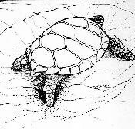
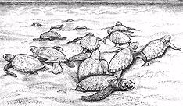
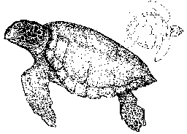
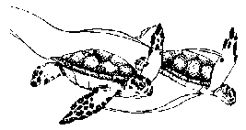
USFWS
Beach lighting
Vehicles
USFWS
Nesting Females
Beach lighting
Introduced predators
Beach renourishment
NMFS
Hatchlings
Shrimp trawls
Gillnets
Other fishing gear
Boat strikes
International waters
Nearshore
Juveniles/Adults
Long-lines
Plastics/Tar Ingestion
Sargassum harvest?
Pelagic Juveniles

Slide 9
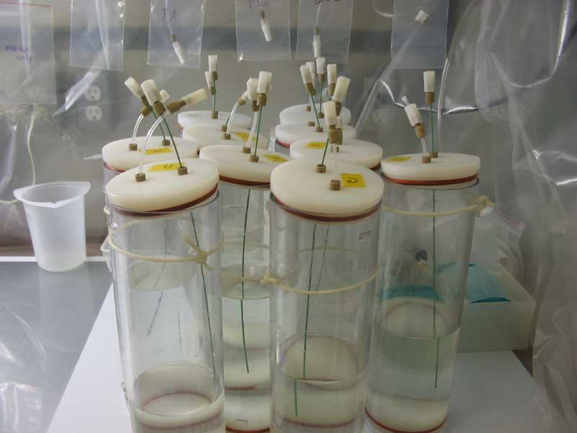

X

Slide 10
A simple stage-structured sea turtle model
(Heppell et al. 1996, 2004)
F₄
Eggs
hatchlings
(age 0)
G₁
Adults
Pelagic
juveniles
P₄
P₂
0 0 0 F₄
G₁ P₂ 0 0
0 G₂ P₃ 0
0 0 G₃ P₄
G₃
Benthic juveniles
G₂
P₃

Slide 11
Year 1
Year 2
Hatchlings
Pelagic
juveniles
Benthic
juveniles
Adults
Hatchlings
Pelagic
juveniles
Benthic
juveniles
Adults
0 0 0 F₄
G₁ P₂ 0 0
0 G₂ P₃ 0
0 0 G₃ P₄
x
=
Do this several times. After a transition period of 2-3 generations, the population will settle into a constant growth rate and stage distribution

Slide 12
Critical result of Crouse et al. 1987 model: protecting nests is insufficient for population recovery when fishery mortality is high

Slide 13
Expected population growth rate (λ) for each option
Population growth rate (annual)

Slide 14
OR
Kemp’s ridley turtle analysis, Heppell et al 1996

Slide 15
Survival elasticities given the proportional contribution of each survival rate to the overall population growth rate (Lepidochelys kempi, Heppell et al. 1996)

Slide 16
Life cycle model sensitivity analysis is useful, but only if you can estimate the change in the survival rate, not simply numbers of individuals
Example: potential change in population growth rate expected with a 5% increase in the annual survival rate of small juveniles
These are difficult numbers to estimate, especially for wide-ranging animals at sea. Usually what we can estimate is the number of animals killed by a fishery, or the number saved by a conservation strategy

Slide 17
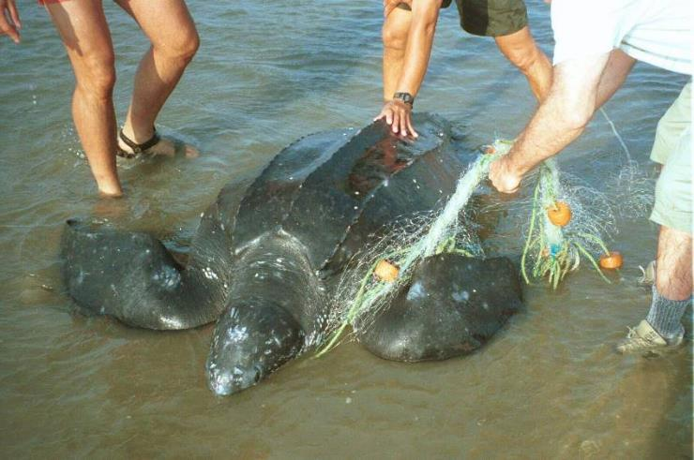
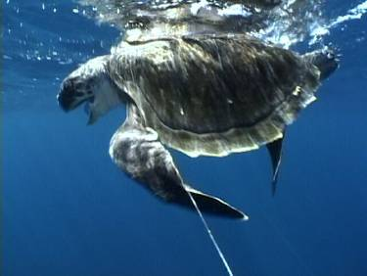
What is the value of saving 100 individuals with a bycatch mitigation strategy?

Slide 18
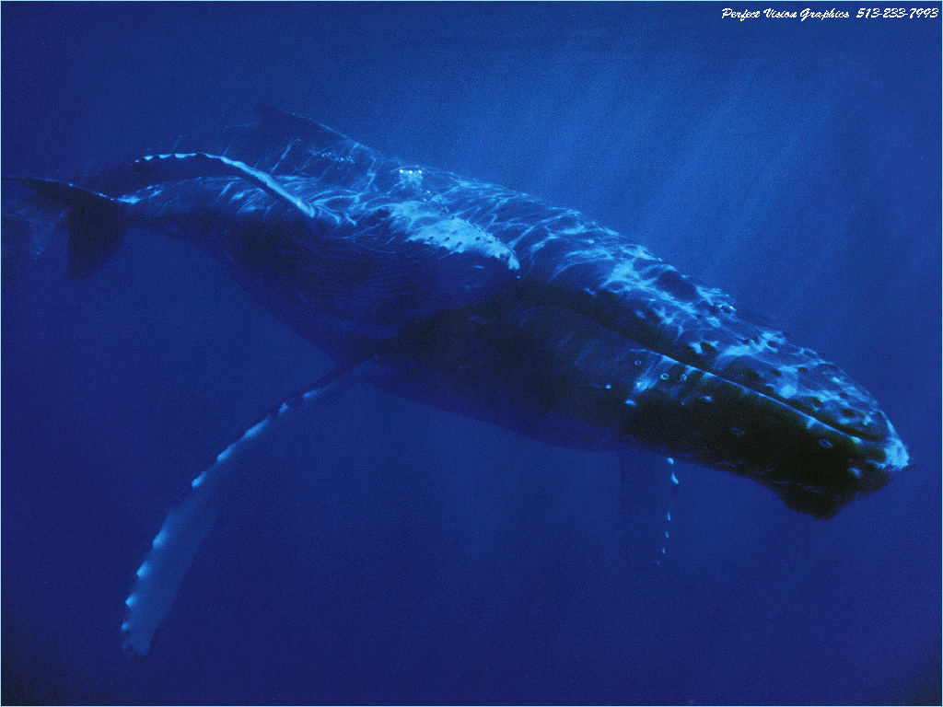

Slide 19
Potential Biological Removal (PBR)
A simple calculation to set a ceiling on bycatch
PBR = 0.5 x R_{max} x F x N_{min}
R_{max} = Maximum Population Growth Rate, in proportional increase per year
F = Recovery Factor (default = 0.1 for endangered species,
0.5 for threatened species)
N_{min} = Minimum Estimate of Population Size (lower confidence interval)

Slide 20
Nmin = 2500 animals

Slide 21
Why PBR works:
Easy to comprehend
Based on measurable parameters
Less information = more conservative take limits
Flexible, can be applied to many different kinds of populations

Slide 22
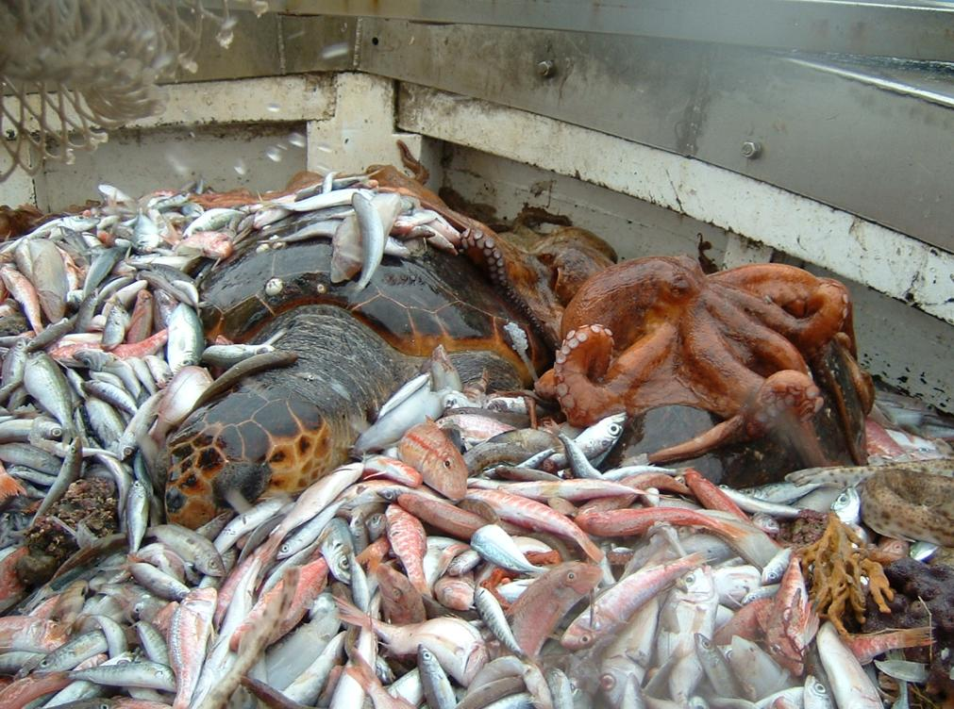
Prioritizing fishery management for loggerhead turtle conservation in the northern Adriatic Sea
Bojan Lazar
Department of Biology
University of Zagreb, Croatia
Selina S. Heppell
Department of Fisheries and Wildlife, Oregon State University, Corvallis, USA

Slide 23
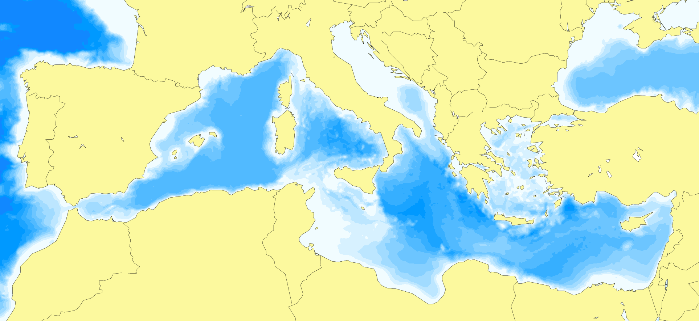
Loggerheads in the Mediterranean
▪ ≈ 5000 nests/year – Greece: 3050 (60%); Turkey: 1370 (27%) – without Libya
▪ remigration period: 2 yrs.
▪ 2280 – 2787 nesting females / year (without Libya)
Adriatic Sea
200 m
200 m
WESTERN MEDITERRANEAN
Chanal of Sicily
200 m
20 - 100
Gulf of Gabès
EASTERN MEDITERRANEAN
>1000
1 - 20
200 m
100 - 1000
< 20

Slide 24
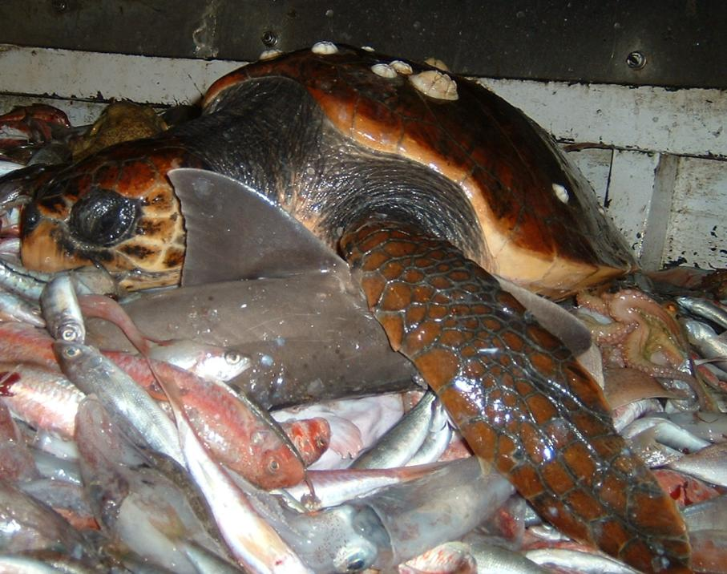
Bottom Trawling
▪ bycatch hot-spot
▪ peak during the “winter”
W Adriatic (Italy) (Casale et al. 2004)
▪ 4273 captures/year
▪ direct mortality: 9.4%
▪ potential mortality: 43.8%
E Adriatic (Croatia, Slovenia)
▪ 2500 captures/year
▪ direct mortality: 7.5 – 12.5%
▪ potential mortality: 26.9%
(Lazar et al. 2003, Lazar 2009)

Slide 25
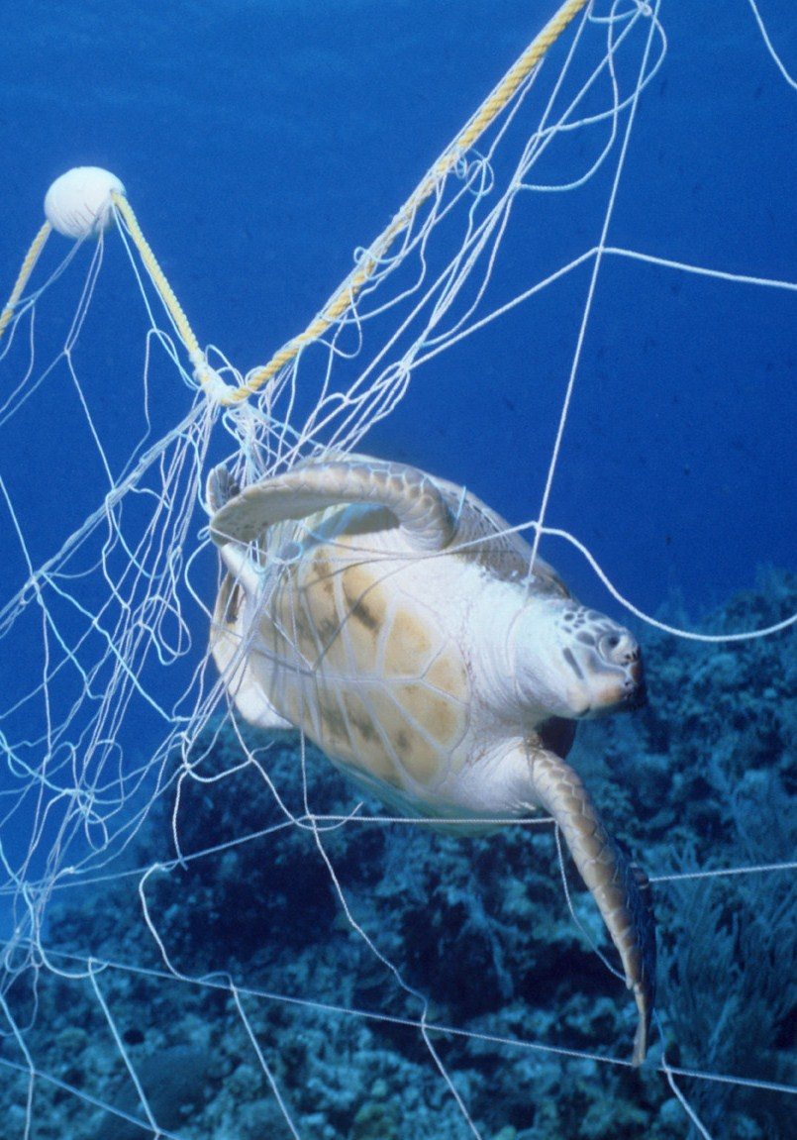
Gill-net bycatch
NE Adriatic (Slovenia, Croatia)
▪ small-boat fishery (7.6 ± 1.6 m)
▪ 90% fleet: < 12 m
Fleet size
▪ 234 exclusive gillnetters
▪ 1203 multi-use vessels
Loggerhead’s bycatch estimate
▪ min. 468 captures/year (excl. gillnetters only)
▪ up to 4035 captures/yr (incl. multiuse vessels)
▪ mortality: 74.0%

Slide 26
 | Bottom trawls | Gillnets
Number of captures | 2500 | 468-4035
Mortality (%) | 7.5-26.9 | 74.0
Total take (N) | 188 - 673 | 346 – 2,985

Slide 27

Gillnets vs. Trawls
?

Slide 28
Reproductive Value (RV)
▪ described by Fisher (1930)
▪ used by various life history researchers (Pianka, Charnov, Caswell)
▪ The relative value of individuals of age- or stage-class x, based on
their current and future reproductive potential
▪ This includes mortality – the probability of surviving to reproductive
age and the expected reproductive lifespan.
▪ One way to calculate: The left eigenvector of a life cycle transition matrix (Caswell 1978)

Slide 29
Matrix results from a simple life cycle model
Dominant eigenvalue λ = 1.241
Eigenvectors:
Stable age distribution Reproductive values
The constant proportion of the population expected in each age class. The values sum to 1.0.
The relative value of individuals in each age class according to their current and expected future offspring (includes mortality). The value of the first age class is set to 1.0.

Slide 30
The process
Determine frequency
of size classes
in each fishery
Translate lengths
to ages using an
age-length relationship
Calculate age-specific
reproductive values
based on a life history
model
Determine the
reproductive values
of turtles in the catch
Determine frequency
of ‘adult equivalents”
in the catch
Compare the total
“adult equivalent” take
for each fishery

Slide 31
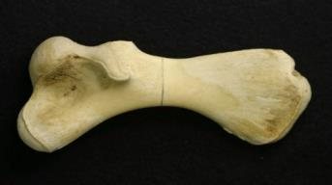
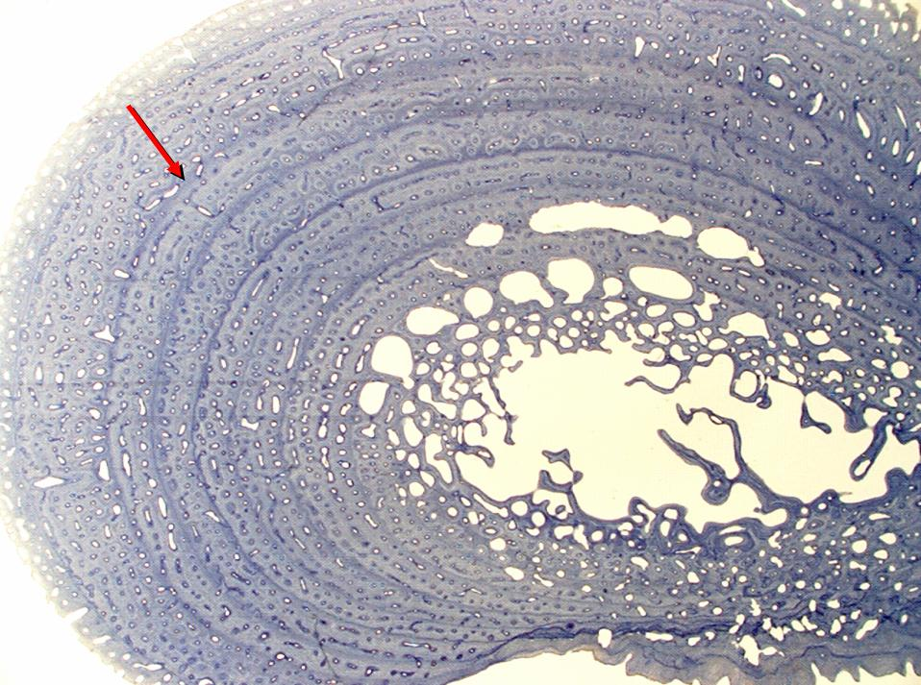
Aging loggerheads
▪ skeletochronology
▪ LAGs (layers of arrested growth) = annual growth rings to estimate size and age
Humerus is usually used, but other bones and sometimes scales also have rings

Slide 32
Age-length relationship
L∞ = 95 cm
L₀ = 4.1 cm
▪ von Bertalanffy growth function
L_{t} = L∞ - (L∞ - L₀)^{–kt}
Growth – two scenarios:
▪ Slow growth (k = 0.060)
▪ Fast growth (k = 0.095)
k = 0.095
k = 0.060
Life stages |  | Stage duration (yrs) |  |  | Age (yrs)
 | CCL |  |  |  | Fast growth |  |  |  | Slow growth
 | (cm) | Fast | Slow |  | Min | Max | Mean |  | Min | Max | Mean
Pelagic juv. | < 30 | 4 | 6 |  | 0 | 3 | 1.8 |  | 0 | 5 | 2.4
Post-pelagic juv. | 30 - 50 | 4 | 6 |  | 4 | 7 | 5.2 |  | 6 | 11 | 8.0
Neritic juv. | 50 - 70 | 6 | 10 |  | 8 | 13 | 10.0 |  | 12 | 21 | 15.6
Adults | > 70 | 48 | 40 |  | 14 |  |  |  | 22

Slide 33
Survival & Reproduction
Reproduction
▪ Low reproduction
▪ High reproduction
 | clutch size | nests/ female | survival | sex ratio | remigration
Low | 85 | 1.5 | 0.3 | 0.5 | 3
High | 110 | 2.5 | 0.7 | 0.8 | 2
4 life-history models:
Model 1 – Fast growth, hi reproduction
Model 2 – Fast growth, low reproduction
Model 3 – Slow growth, hi reproduction
Model 4 – Slow growth, low reproduction
Testing distributions of potential impacts for each fishery
Life stage | Survival
 | Slow model | Fast model
Juveniles < 1 year | 0.25 | 0.25
Pelagic juv. (CCL < 30 cm) | 0.75 | 0.70
Post-pelagic juv. (CCL = 30.0 – 50.0) | 0.85 | 0.80
Neritic juv. (CCL = 50.0 – 70.0) | 0.90 | 0.85
Adults (CCL > 70.0) | 0.95 | 0.90

Slide 34
Matrix: Fast growth, hi reproduction
age | 0 | 1 | 2 | 3 | 4 | 5 | 6 | 7 | 8 | 9 | 10 | 11 | 12 | 13 | 14
0 | 0 | 0 | 0 | 0 | 0 | 0 | 0 | 0 | 0 | 0 | 0 | 0 | 0 | 86.4 | 91.2
1 | 0.25 | 0 | 0 | 0 | 0 | 0 | 0 | 0 | 0 | 0 | 0 | 0 | 0 | 0 | 0
2 | 0 | 0.7 | 0 | 0 | 0 | 0 | 0 | 0 | 0 | 0 | 0 | 0 | 0 | 0 | 0
3 | 0 | 0 | 0.7 | 0 | 0 | 0 | 0 | 0 | 0 | 0 | 0 | 0 | 0 | 0 | 0
4 | 0 | 0 | 0 | 0.7 | 0 | 0 | 0 | 0 | 0 | 0 | 0 | 0 | 0 | 0 | 0
5 | 0 | 0 | 0 | 0 | 0.8 | 0 | 0 | 0 | 0 | 0 | 0 | 0 | 0 | 0 | 0
6 | 0 | 0 | 0 | 0 | 0 | 0.8 | 0 | 0 | 0 | 0 | 0 | 0 | 0 | 0 | 0
7 | 0 | 0 | 0 | 0 | 0 | 0 | 0.8 | 0 | 0 | 0 | 0 | 0 | 0 | 0 | 0
8 | 0 | 0 | 0 | 0 | 0 | 0 | 0 | 0.8 | 0 | 0 | 0 | 0 | 0 | 0 | 0
9 | 0 | 0 | 0 | 0 | 0 | 0 | 0 | 0 | 0.85 | 0 | 0 | 0 | 0 | 0 | 0
10 | 0 | 0 | 0 | 0 | 0 | 0 | 0 | 0 | 0 | 0.85 | 0 | 0 | 0 | 0 | 0
11 | 0 | 0 | 0 | 0 | 0 | 0 | 0 | 0 | 0 | 0 | 0.85 | 0 | 0 | 0 | 0
12 | 0 | 0 | 0 | 0 | 0 | 0 | 0 | 0 | 0 | 0 | 0 | 0.85 | 0 | 0 | 0
13 | 0 | 0 | 0 | 0 | 0 | 0 | 0 | 0 | 0 | 0 | 0 | 0 | 0.85 | 0 | 0
14 | 0 | 0 | 0 | 0 | 0 | 0 | 0 | 0 | 0 | 0 | 0 | 0 | 0 | 0.85 | 0.95

Slide 35
Reproductive value calculation
▪ Software: “PopTools” (http://www.cse.csiro.au/poptools/)
▪ Excel add-in for analysis of matrix population models, simulation of
stochastic processes and calculation of bootstrap
▪ RV: the “left eigenvector” of a transition matrix (Caswell 1978)
→ RV of each age-class
▪ RV of each age-class scaled to RV of adults (adult RV = 1)
→ “Adult Equivalents” (relative value of individuals in each age-
classes in comparison to adult)

Slide 36
Model results – reproductive values
Reproductive value, relative to adult
“Adult Equivalent”
Age

Slide 37
Gillnetters vs. Trawls
▪ Exclusive gillnetters vs. Trawls, N Adriatic, Slovenia + Croatia
Adult equivalents removed annually

Slide 38
Gillnetters vs. Trawls: Croatia
▪ Exclusive gillnetters vs. Trawls
Adult equivalents removed annually

Slide 39
Gillnetters vs. Trawls: Slovenia
▪ Exclusive gillnetters vs. Trawls
Adult equivalents removed annually

Slide 40
Gillnetters vs. Trawls
...if multi-use vessels are added:
Adult equivalents removed annually

Slide 41
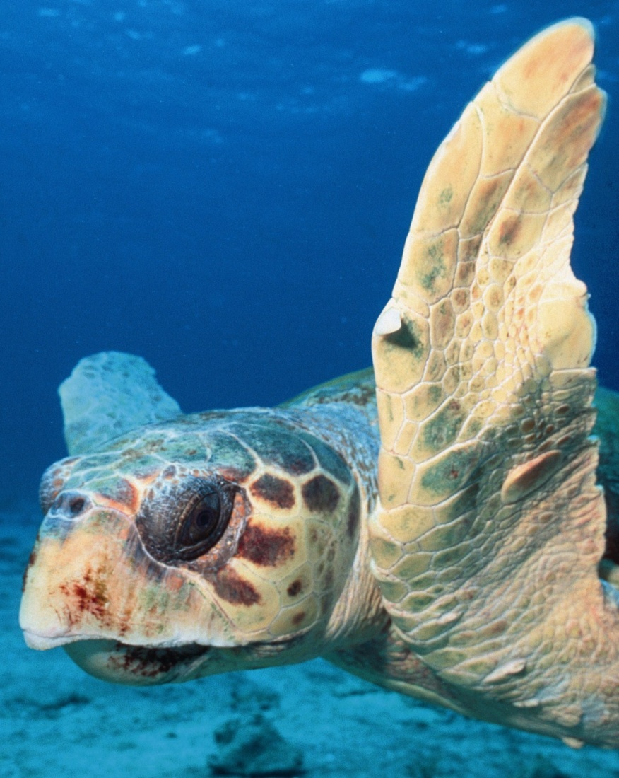
So...
▪ Trawl bycatch should be of greater concern for management in the N. Adriatic unless gillnet bycatch by multi-use vessels is significant.
▪ Adult equivalents are a useful way to compare the potential impacts of harvest that affects particular size/age classes.
▪ Major gap: fishing effort of multi-use vessels.

Slide 42
Biologists are a bit skeptical of models (sometimes):
MODEL
DATA
(that took a long time
and a lot of
effort to collect)
RESULTS
(that may not match
experience or
expectations)
Management
Decisions??

Slide 43
Models can be used for many things
Prediction – how many fish, how much catch, future trends?
Relative impacts – which threat should be reduced first?
Conservation strategy evaluation – which conservation efforts will be most likely to work or help a species the most?
Monitoring strategy evaluation – which data will give us the best information?

Slide 44
Models can be misused or misinterpreted if they are not constructed well or have too many uncertainties
Understand what the model is for – what are the questions or management needs?
Too many unknowns = anything can happen, and the results may not be informative (“garbage in = garbage out”)
All models include assumptions that are likely violated. That’s OK, as long as you investigate how the results of the model are affected by those assumptions.
Models are often not explained very well to the public. This can lead to misinterpretation, too much belief in results, or lack of trust. Learn how to explain what you’ve done and why, and be open to trying new assumptions or parameters based on local knowledge and expertise.

